Slide 1
SCIENTIFIC COMPUTING
LECTURE # 5
1

Slide 2
Plotting
Basic X-Y Plotting
Line Specification Options
Combining two graphs
The figure window

Slide 3
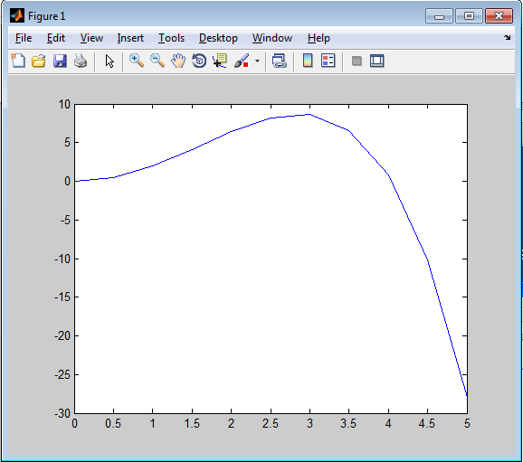
Basic X-Y Plotting
>> time = 0:0.5:5;
>> height = (2.13 * time .^ 2 - 0.13 * time .^ 4 + 0.000034 * time .^ 4.752);
>> plot(time,height);
Neat! But not very readable.
A window pops up with the graph is it
3

Slide 4
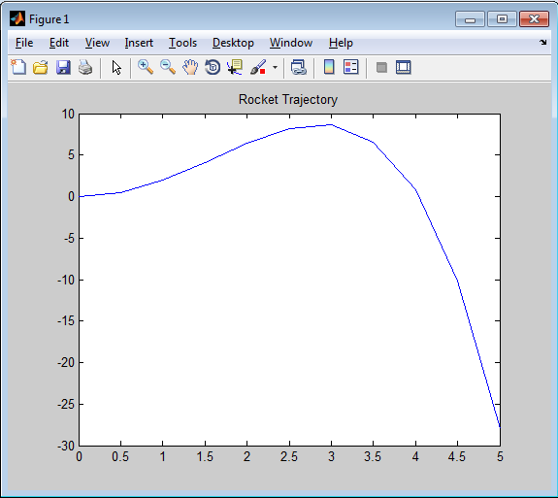
Give it a name
>> time = 0:0.5:5;
>> height = (2.13 * time .^ 2 - 0.13 * time .^ 4 + 0.000034 * time .^ 4.752);
>> plot(time,height);
>> title('Rocket Trajectory');
4

Slide 5
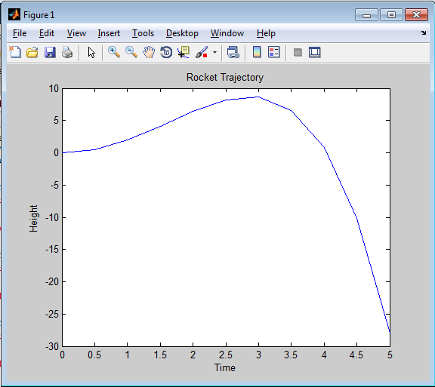
And make it readable
>> time = 0:0.5:5;
>> height = (2.13 * time .^ 2 - 0.13 *
>> plot(time,height); time .^ 4 + 0.000034 * time .^ 4.752);
>> title('Rocket Trajectory');
>> xlabel('Time');
>> ylabel('Height');
5

Slide 6
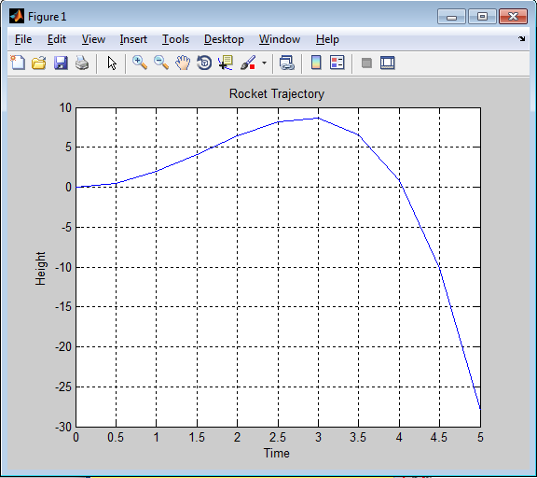
Add a grid to trace x and y coordinates
>> time = 0:0.5:5;
>> height = (2.13 * time .^ 2 - 0.13 * time .^ 4 + 0.000034 * time .^ 4.752);
>> plot(time,height);
>> title('Rocket Trajectory');
>> xlabel('Time');
>> ylabel('Height');
>> grid
Rocket hits the ground (height = 0) approximately at time = 4 seconds
6

Slide 7
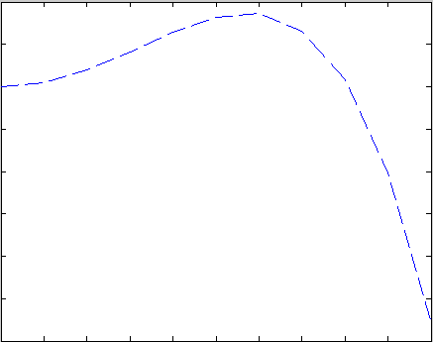
Change the look of the graph
>> time = 0:0.5:5;
>> height = (2.13 * time .^ 2 - 0.13 * time .^ 4 + 0.000034 * time .^ 4.752);
>> plot(time,height,’--’);
>> title('Rocket Trajectory');
>> xlabel('Time');
>> ylabel('Height');
Added a format field. ‘- -‘means dashed line
7

Slide 8
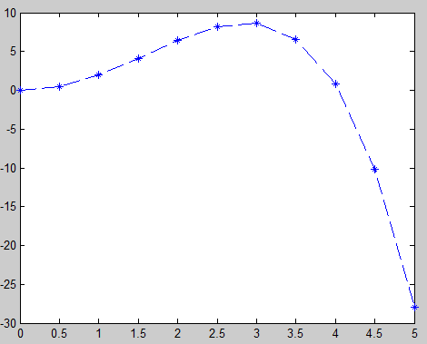
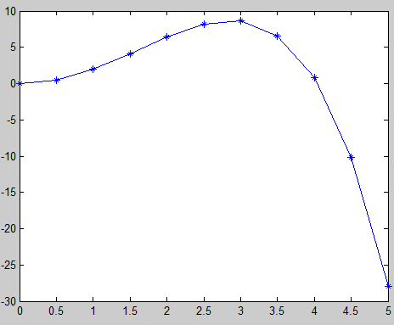
Change the look of the graph
>> time = 0:0.5:5;
>> height = (2.13 * time .^ 2 - 0.13 * time .^ 4 + 0.000034 * time .^ 4.752);
>> plot(time,height,’*-’);
>> title('Rocket Trajectory');
>> xlabel('Time');
>> ylabel('Height');
Solid graph line and * to mark data points
8

Slide 9
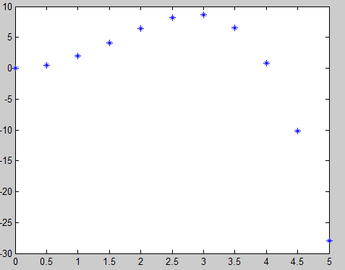
Change the look of the graph
>> time = 0:0.5:5;
>> height = (2.13 * time .^ 2 - 0.13 * time .^ 4 + 0.000034 * time .^ 4.752);
>> plot(time,height,’*’);
>> title('Rocket Trajectory');
>> xlabel('Time');
>> ylabel('Height');
* to mark datapoints – no graph line
9

Slide 10
Line Specification Options
b blue . point - solid
g green o circle : dotted
r red x x-mark -. dashdot
c cyan + plus -- dashed
m magenta * star (none) no line
y yellow s square
k black d diamond
w white v triangle (down)
^ triangle (up)
< triangle (left)
> triangle (right)
p pentagram
h hexagram
Line type
Line color
Marker
10
10

Slide 11
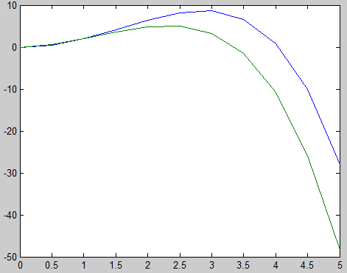
Combining two graphs
>> time = 0:0.5:5;
>> height1 = (2.13 * time .^ 2 - 0.13 * time .^ 4 + 0.000034 * time .^ 4.752);
>> height2 = 2.13 * time .^ 1.7 - 0.13 * time .^ 4 + 0.000034 * time .^ 4.752;
>> plot(time,height1,time,height2);
>> title('Rocket Trajectory');
>> xlabel('Time');
>> ylabel('Height');
plot(x1,y1,x2,y2,….)
Every pair of parameters represents a graph.
11

Slide 12
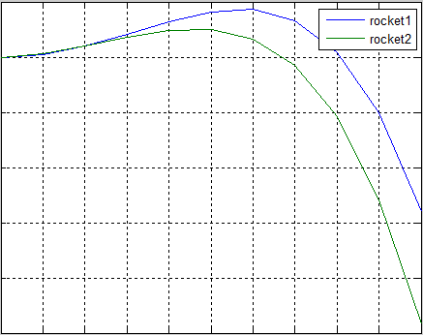
Another way to combine graphs
>> time = 0:0.5:5;
>> height1 = (2.13 * time .^ 2 - 0.13 * time .^ 4 + 0.000034 * time .^ 4.752);
>> height2 = 2.13 * time .^ 1.7 - 0.13 * time .^ 4 + 0.000034 * time .^ 4.752;
>> TwoHeights = [height1; height2];
>> plot(time,TwoHeights);
>> title('Rocket Trajectory');
>> xlabel('Time');
>> ylabel('Height');
>> legend('rocket1','rocket2');
>> grid
Combine 2 vectors for y and send them to be plotted against the same x
12

Slide 13
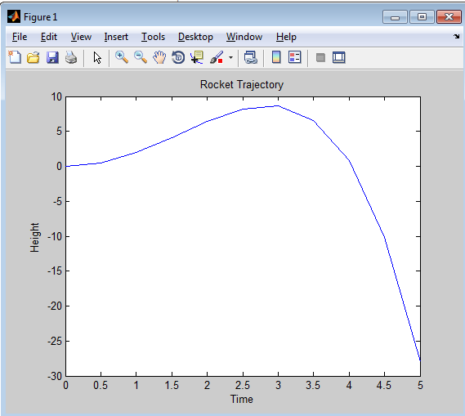
The figure window
You can save the graph as an image (to insert in any document) through the figure window that pops up when you execute a graph command
13

Slide 14
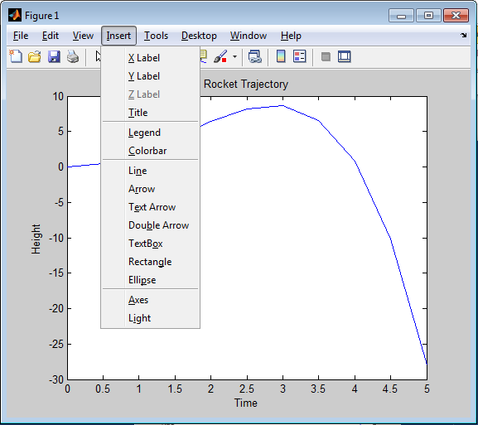
The figure window
You can also manipulate the
graph through the menus
provided
14

Slide 15
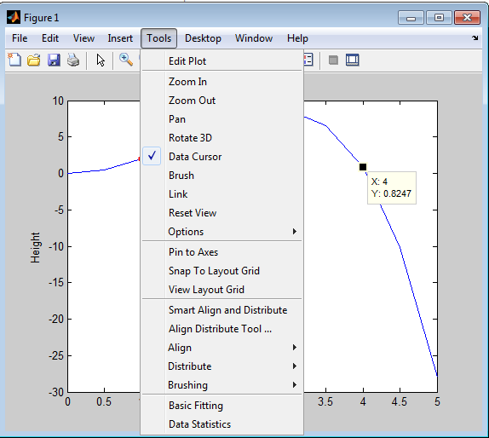
The figure window
You can also manipulate the graph through the menus provided
15

Slide 16
Any Questions

